Slide 1
Plant Disease Recognition: Comparison of CNNs
and Transfer Learning Models
Teammates:
1. Pravalika Kuppireddy; 44469034
2. Harika Kanala; 59065105

Slide 2
Project Overview
Plant diseases significantly impact crop yield and agricultural productivity, making early and accurate detection essential. Traditional diagnosis methods rely on manual inspection by experts, which is time-consuming, subjective, and difficult to scale.
Recent advances in computer vision and deep learning have enabled automated plant disease detection using leaf images. In this project, we apply Convolutional Neural Networks (CNNs) to classify plant leaves into three categories: Healthy, Powdery mildew, and Rust. We evaluate both a custom CNN trained from scratch and transfer learning approaches using pre trained deep networks, demonstrating the effectiveness of deep learning for reliable and efficient plant disease classification.
Problem statement:
Develop a robust image classification system that can accurately classify plant leaves into:
Healthy
Powdery
Rust
Motivation:
Real-world images are noisy and harder than lab datasets.
Subtle symptoms (especially Powdery) are visually similar to healthy leaves.
Small dataset size makes training deep models challenging.

Slide 3
Literature Review
Early work by Mohanty et al. (2016) demonstrated high CNN accuracy on controlled datasets like PlantVillage.
Sladojevic et al. and Ferentinos confirmed CNN effectiveness under clean backgrounds.
Later studies showed poor generalization of scratch CNNs on real field images.
Too et al. (2019) showed that transfer learning consistently outperforms scratch CNNs on small plant datasets.
He et al. (ResNet) introduced residual connections to stabilize deep training.
Tan & Le (EfficientNet) proposed compound scaling to balance performance and efficiency.
Literature strongly supports transfer learning for limited agricultural datasets.
The literature strongly suggests that dataset size and image realism play a crucial role in model performance, and that transfer learning is more reliable than training CNNs from scratch for real-world plant disease recognition tasks. These findings directly motivate the modeling choices and experimental comparisons in this project.

Slide 4
Dataset Description
Dataset source: Kaggle – Plant Disease Recognition Dataset
The Plant Disease Recognition Dataset is from Kaggle. It contains real-world photographs of plant leaves captured under natural outdoor conditions. The dataset includes three classes: Healthy, Powdery Mildew, and Rust, and is organized into predefined training, validation, and test splits.
Total images: 1532
Training: ~430–460 images per class
Validation: 60 images total (20 per class)
Test: 150 images (50 per class)
Images are high resolution (up to 5184×3456) with outdoor backgrounds.
Dataset reflects real-world conditions, not controlled lab environments.

Slide 5
Exploratory Data Analysis
Exploratory data analysis was performed to understand dataset quality and visual characteristics.
All images were verified to be readable RGB images, and checks confirmed that there were no corrupted files or exact duplicates.
Class balance was consistent across training, validation, and test splits.
Analysis of image dimensions showed that most images are high resolution with similar aspect ratios, allowing safe resizing without distortion.
Color and brightness statistics indicated that green is the dominant channel across all classes.
Rust images tend to appear slightly darker, while Powdery images often appear brighter, although these trends overlap significantly.
Visual inspection revealed that Rust has strong lesion patterns, whereas Powdery symptoms are subtle and visually similar to Healthy leaves.

Slide 6
Preprocessing & Data Augmentation
To ensure efficient and stable training, all images were resized to fixed input sizes. Scratch CNN models were trained at 128×128, while pretrained models used 224×224 inputs to match standard architectures.
Pixel values were normalized before being fed into the network.
Data augmentation was applied only to the training set to improve generalization. Augmentations included random flips, small rotations, zooming, and brightness or contrast variations.
These transformations help reduce sensitivity to lighting changes, orientation differences, and background noise, while preserving disease-related visual patterns. Validation and test images were not augmented to ensure fair evaluation.

Slide 7
Baseline CNN Architecture
Architecture:
Multiple convolutional layers + ReLU
MaxPooling for spatial reduction
Dropout and L2 regularization
Dense softmax output layer (3 classes)
Optimizer: Adam
Loss function: Sparse categorical cross-entropy
Trained at two resolutions:
128×128
224×224
Observation: Higher resolution alone did not improve scratch CNN performance.
- Baseline convolutional neural networks were trained from scratch to establish a reference for model performance and to understand how much information can be learned directly from the dataset.
- The baseline architecture consists of multiple convolutional and max-pooling layers followed by fully connected layers with dropout and L2 regularization to reduce overfitting. These models were trained using the Adam optimizer and categorical cross-entropy loss.
- Two input resolutions were evaluated: 128×128 and 224×224. While the baseline CNN achieved strong test accuracy, it showed unstable validation behavior and consistent confusion between visually similar classes, particularly Healthy and Powdery.

Slide 8
Improved CNN Model
An improved CNN architecture was implemented to address limitations observed in the baseline model, particularly class confusion and training instability. The improved model increased network depth and incorporated batch normalization to stabilize learning under varying lighting conditions. Additional regularization techniques were used to limit overfitting.
Although the improved CNN achieved comparable test accuracy to the baseline model, it did not significantly reduce misclassification between Healthy and Powdery classes. This indicates that architectural changes alone are insufficient when training data is limited and disease features are subtle.
Motivation: Reduce confusion between Healthy and Powdery classes.
Improvements:
Increased depth
Batch normalization to stabilize training
Stronger regularization
Trained for more epochs with early stopping.
Results:
Comparable accuracy to baseline CNN
Still struggled with Powdery vs Healthy
Insight: Model capacity alone cannot overcome limited data and subtle visual cues

Slide 9
Transfer Learning Overview & Pre trained Models
To overcome data limitations, transfer learning was employed using deep neural networks pretrained on ImageNet. Pretrained models provide strong low-level and mid-level visual features such as edges, textures, and shapes, which are transferable to plant disease images.
A two-stage training strategy was used:
Frozen backbone training, where only the classification head is trained
Fine-tuning, where selected deeper layers are unfrozen with a low learning rate
This approach improves convergence speed and generalization while reducing overfitting risk.
Three pretrained architectures were evaluated to capture different design philosophies:
VGG16 uses deep stacks of convolutional filters and is effective for texture-based tasks.
ResNet50 employs residual connections that enable stable training of deeper networks.
EfficientNetB0 balances depth, width, and resolution, achieving strong performance with fewer parameters.

Slide 10
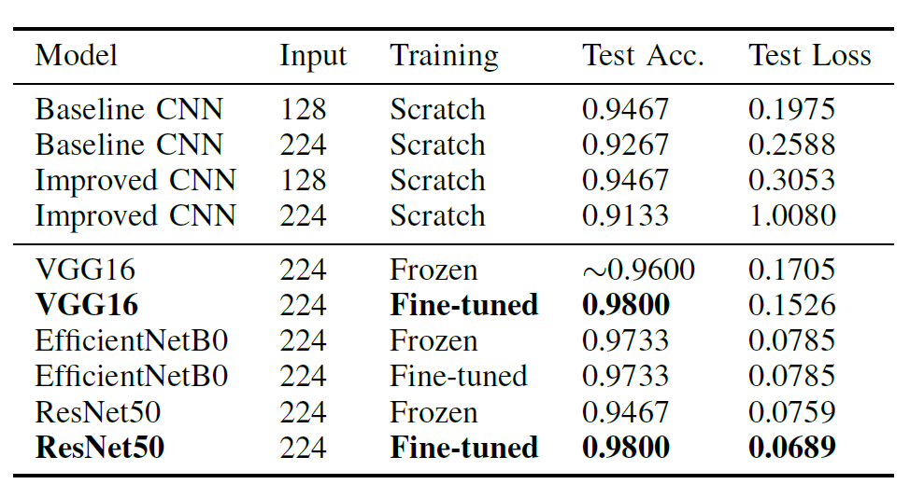
Results
CNN models achieved reasonably high test accuracy but exhibited unstable validation behavior and frequent confusion between Healthy and Powdery classes. In contrast, transfer learning models converged faster and showed smoother validation curves.
Fine-tuned VGG16 and ResNet50 achieved the highest test accuracy, while EfficientNetB0 provided strong and stable performance with fewer parameters. Confusion matrix analysis showed that transfer learning significantly reduced misclassification between visually similar classes, while Rust was consistently classified correctly.

Slide 11
Results 2

Slide 12
Challenges & Limitations
The primary limitation of this project is the small validation dataset, which led to noisy validation metrics and sensitivity to individual samples. Subtle visual differences between Healthy and Powdery leaves further increased classification difficulty. Background clutter and lighting variations also introduced noise that affected scratch CNN performance.
Additionally, pretrained models required careful hyperparameter tuning and higher computational cost, particularly during fine-tuning. These factors highlight the trade-offs between model complexity and dataset size.

Slide 13
Conclusion

